Slide 1

What to eat?
Hua Chen, Tomoko Takami, Yerold Sanabria Rios and Eveliina Hampus

Slide 2

Roles Challenges Teamwork Sprints Data What was learned?

Slide 3

Roles
Hua Chen Frontend developer and tester
Yerold Sanabria Backend developer
Tomoko Takami Frontend developer and designer
Eveliina Hampus Product owner and scrum master

Slide 4

Challenges
At the beginning, after two weeks, two members decided to leave project. It caused some uncertainty of everyone’s duties and hindered progression. The roles changed due new formation.
Keeping up with daily meetings was very unsuccessful, but everyone kept everybody informed of their whereabouts via whatsapp almost daily.
Some stress was caused by Git, and required everyone try to study it more.

Slide 5

Constant communication and teamwork. Staying in touch often and clarifying misunderstandings early.

Slide 6
Overview of sprints
Often too much workload per sprint or otherwise badly timed tasks.
Updating of progress and personal work was not consistent.
Some sprints were very successful, that helped to estimate upcoming springs.

Slide 7
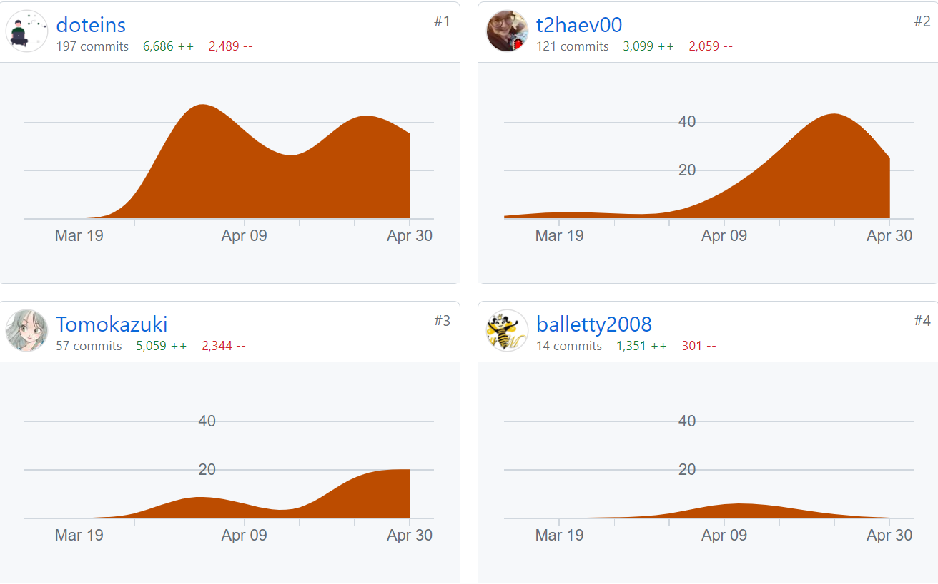
Data from HacknPlan & Github
Data recorded as by 3.5. 10PM. May not be full reality, and lesson and whatsapp contact time was excluded.

Slide 8

What was learned?
Stronger need for daily 15min meetings.
Rethink workload.
More time for designing features at the beginning.
Spending more time together off project for bonding and better communication.
Backend and frontend coding, connection them, Typescript and SQL queries.

Slide 9

Thank you!
By: Groud D

